Slide 1
Introduction to data warehousing
MTN.BI.07
Oracle Relational Structures
Elias Nema
Lead Software Engineer
Elias_Nema@epam.com

Slide 2
Agenda
Table Creation
Types of Tables (Heap organized tables, Index Organized tables etc.)
Types of Indexes (B*Tree indexes, B*Tree cluster indexes etc.), Benefits of IOTs
Table Clusters and Benefits of Usage

Slide 3
Table Creation

Slide 4

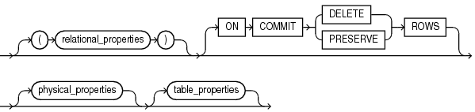
Syntax

Slide 5
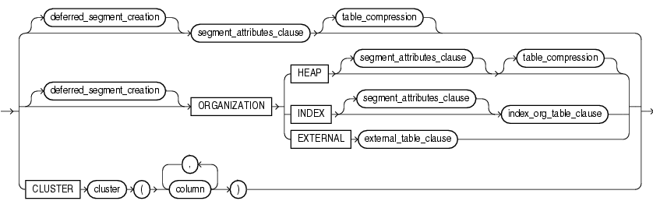
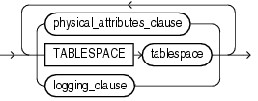
Still trying to create a table

Slide 6
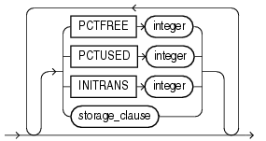
Still trying to create a table

Slide 7
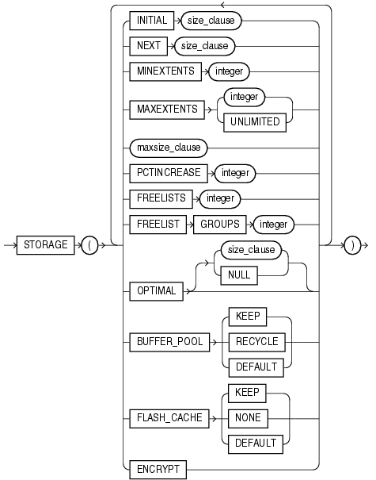
Still trying to create a table

Slide 8
Data Blocks, Again?
Oracle inserts multiple rows into single data block (if row size is smaller than block size)
Sometimes a row will occupy more than one block:
if a row size is larger than data block size – data chaining
if a row is inserted small and then updated and there is no space left in the data block – data migration
Data chaining is unavoidable, Oracle tries to prevent data migration

Slide 9
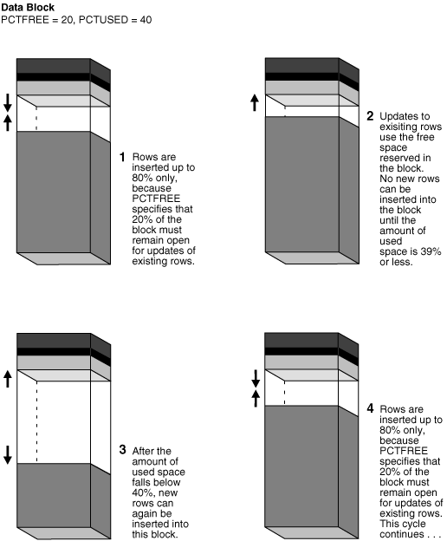
PCTFREE and PCTUSED

Slide 10
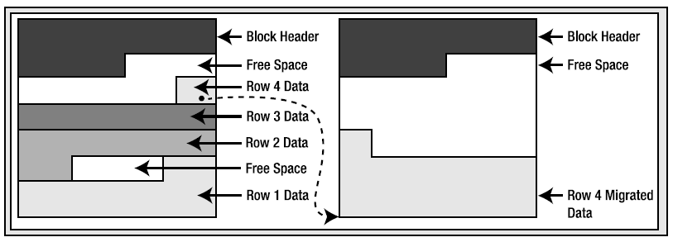
Row Migration
Row migration is when a row is forced to leave the block it was created on because it grew too large to fit on that block with the rest of the rows.
When Oracle migrates the row, it will leave behind a pointer to where the row really is.

Slide 11
tables

Slide 12
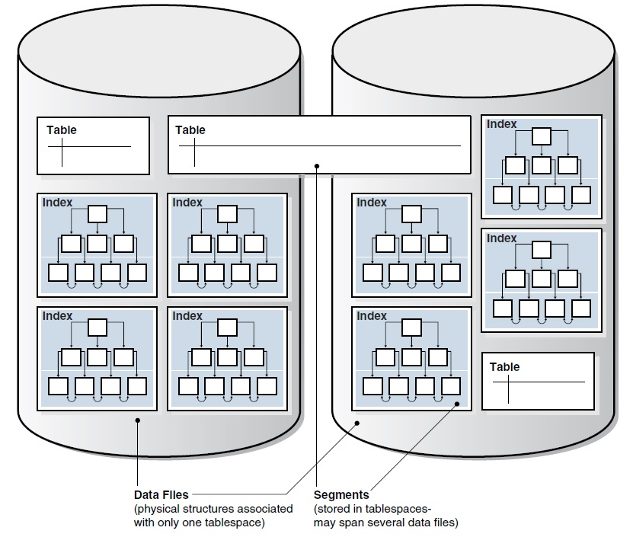
Review of Structures Relationships

Slide 13
Main Types of Tables in Oracle
Heap organized tables
Index organized tables
Index clustered tables
Hash clustered tables
Sorted hash clustered tables
Temporary tables
External tables
…

Slide 14
Heap-Organized Table
Does not store rows in any particular order.
The CREATE TABLE statement creates a heap-organized table by default (used 99 percent of the time).
It is a big area of space or memory that is managed in an apparently random fashion.
Data will be placed where it fits best, rather than in any specific sort of order.
Heap

Slide 15
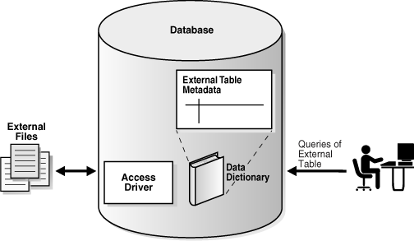
External Table
An external table is a read-only table whose metadata is stored in the database but whose data is stored outside the database. They are most useful as a means of getting data into the database (they are a very powerful data-loading tool). Furthermore they provide an easy way to move data between Oracle databases without using database links.

Slide 16
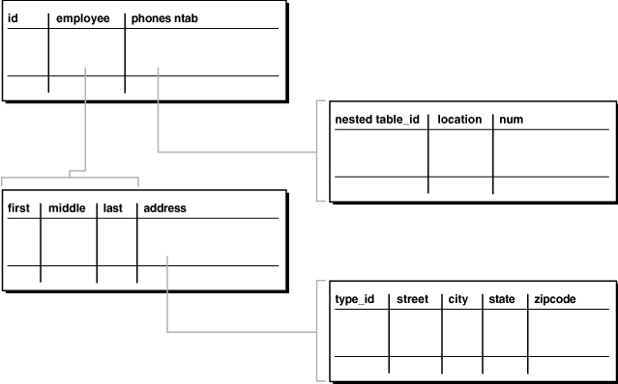
Object Table
Object type: A schema object that abstracts a real-world entity.
Object tables: These tables are created based on an object type. They have special attributes not associated with non-object tables, such as a system-generated REF(object identifier) for each row.

Slide 17
indexes

Slide 18
Indexing
An index is an optional structure, associated with a table or table cluster, that can SOMETIMES speed data access. Indexes are one of many means of reducing disk I/O.
A column that is frequently referred to in the WHERE clause is a potential candidate for indexing.
The Oracle Database server automatically modifies the values in the index when the values in the corresponding columns are modified.

Slide 19
Indexing. Types
Standard B*-tree
Reverse key
Bitmap
Function-based

Slide 20
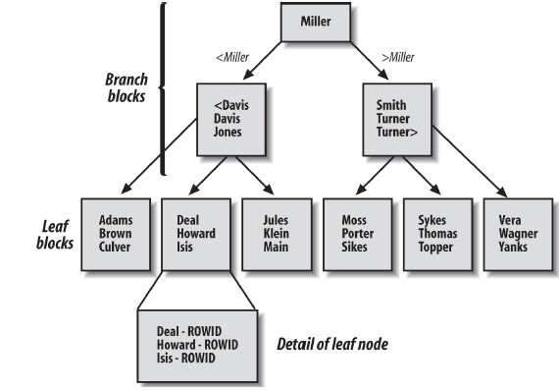
Balanced Tree Indexes
These indexes are the standard index type. They are excellent for highly selective indexes (few rows correspond to each index entry) and primary key indexes.

Slide 21
B*tree Indexes Subtypes
Index-organized tables
Reverse key indexes
Descending indexes
B-tree cluster indexes
Bitmap and bitmap join indexes

Slide 22
Maintaining Indexes
On every relation, Oracle creates a non-clustered B*tree index for the primary key
Additionally Oracle will also create an index for every UNIQUE constraint
Indexes are automatically used to improve the performance of queries issued to the database, and to sort queries with an ORDER BY clause
Once an index is created, it is never referenced in a SQL statement again except to validate it (VALIDATE INDEX) or delete it (DROP INDEX)
Indexes cannot be created for views (add an index to the underlying base table)

Slide 23
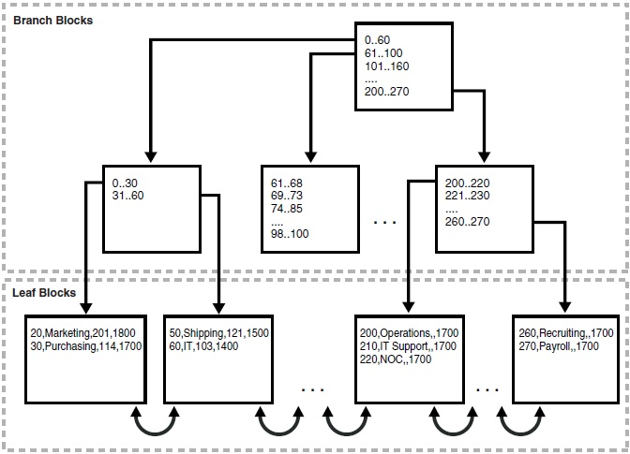
Index-Organized Tables
IOTs are stored in an index structure. The data is stored in sorted order, according to the primary key.
Useful if frequent access to complete table via the index

Slide 24
Reverse Key Index
A reverse-key index is advantageous in environments where an application inserts ascending indexed values while deleting lower values. It physically reverses the bytes of each index key.
Data warehouse applications that insert and delete large amounts of information based on a key range, such as a date, benefit the most from this.
ID | Reverse ID | ROWID
100 | 001 | AAAD7fAA…….A
101 | 101 | AAAD7fAA…….B
107 | 701 | AAAD7fAA…….C
108 | 801 | AAAD7fAA…….D
110 | 011 | AAAD7fAA…….E
Index | ROWID
001 | AAAD7fAA…….A
011 | AAAD7fAA…….E
101 | AAAD7fAA…….B
701 | AAAD7fAA…….C
801 | AAAD7fAA…….D

Slide 25
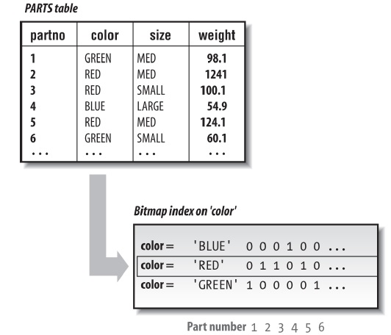
Bitmap Indexes
Index entry uses a bitmap to point to multiple rows
Each bit in the index represents a ROWID. A mapping function converts the bit into its corresponding ROWID.

Slide 26
Clusters

Slide 27
Overview of Table Clusters
A table cluster is a group of tables that share common columns and store related data in the same blocks. When tables are clustered, a single data block can contain rows from multiple tables.
Properly used table clusters offer the following benefits:
Disk I/O is reduced for joins of clustered tables.
Access time improves for joins of clustered tables.
Less storage is required to store related table and index data because the cluster key value is not stored repeatedly for each row.
Typically, clustering tables is not appropriate in the following situations:
The tables are frequently updated.
The tables frequently require a full table scan.
The tables require truncating.

Slide 28
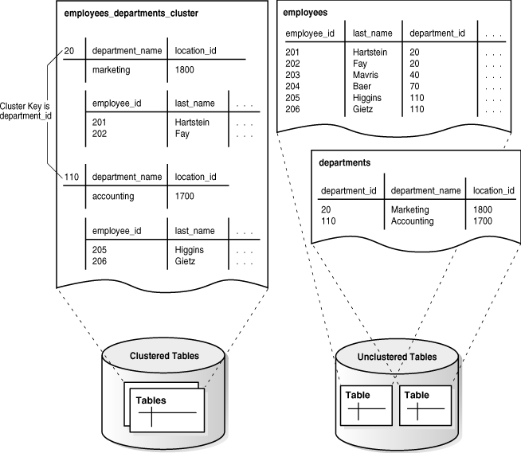
Indexed Cluster
Notes:
The cluster includes a cluster index, which stores all the values for the corresponding cluster key. Each value in the cluster index points to a data block that contains only rows with the same value for the cluster key.
Full table scans on clustered tables can actually require more I/O operations, lowering overall performance.

Slide 29
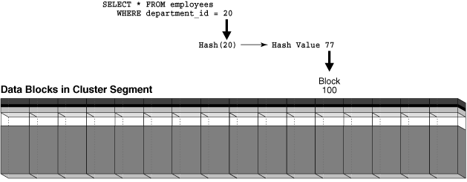
Hash Cluster
A hash cluster is like a index cluster with one significant difference that makes it even faster. Each request for data in a clustered table involves at least two I/O operations, one for the cluster index and one for the data. A hash cluster stores related data rows together, but groups the rows according to a hash value for the cluster key.

Slide 30
Oracle Relational Structures
Elias Nema
Lead Software Engineer
Elias_Nema@epam.com

